Slide 1

Library management using Flutter
RNS INSTITUTE OF TECHNOLOGY
BENGALURU - 98
DEPARTMENT OF INFORMATION SCIENCE & ENGINEERING
Presentation on Internship
Ishanu Agarwal
1RN18IS054
ENMAZ Engineering Services Pvt. Ltd.
Internal Guide
Mrs.Vanishri S.
Associate Prof, Dept of ISE, RNSIT
External Guide
Mr. Akshay D R
Co-Founder & CEO, Enmaz Engineering Services Pvt. Ltd., Bangalore

Slide 2
AGENDA
Abstract
About the Company
Introduction
Literature survey
Requirements
System Design
Implementation
Results
Testing
Conclusion and Future Enhancements
References
Q & A

Slide 3
ABSTRACT
This is a simply and beautify android Library management with OpenTrivia Api.
The android Library management gain your knowledge and understanding in different areas.
The user is able to select the number of books he/she wants to lend. This application has different category of books.
The user is also able to select the types of books he wishes to lend.

Slide 4
ABOUT THE COMPANY
Enmaz Engineering Pvt. Ltd is a Service based company founded in the year 2019.
It specializes in
Embedded H/W Development
Embedded Firmware Development
Cloud support
Big Data Analysis and Reporting
Dashboard UX/UI design and development
Model Analysis.

Slide 5
INTRODUCTION
In today’s world, Smart phones have changed our lives and have become an indispensable part of our lives because of its specialty to simplify our routine work and thereby saving our time.
Currently most of the Examination like organizational recruitment, University class test are paper based, which costs time and resources. Questionnaire is developed, printed, and then collect data, entry, editing, cleaning, which time consuming and costly.
Proposed application is the starting for avoid those circumstances which are been currently faced by any organization.

Slide 6
LITERATURE SURVEY
Library management App using Android Studio:Vaibhavi Balaji Kunale, et. al. International Journal of Engineering Research and Applications www.ijera.com ISSN: 2248-9622, Vol. 11, Issue 6, (Series-II) June 2021, pp. 39-41.
Android is rapidly getting famous, and therefore the number of its users are increasing day by day, because it's easy to access the required Android-based apps on tablets and smartphones .
Therefore, we found the use of the Android App is less complicated and longer efficient to facilitate the users during this way with none difficulty.

Slide 7
REQUIREMENTS
Hardware Requirements
CPU: Pentium processor and above
RAM: 4 GB
HDD: 40 GB
Software Requirements
Operating System: Windows 8 and above
Editor: Visual Studio Code
IDE: VS Code
Front-end Language: Dart
Minimum Android Version : Froyo (API Level 8)

Slide 8
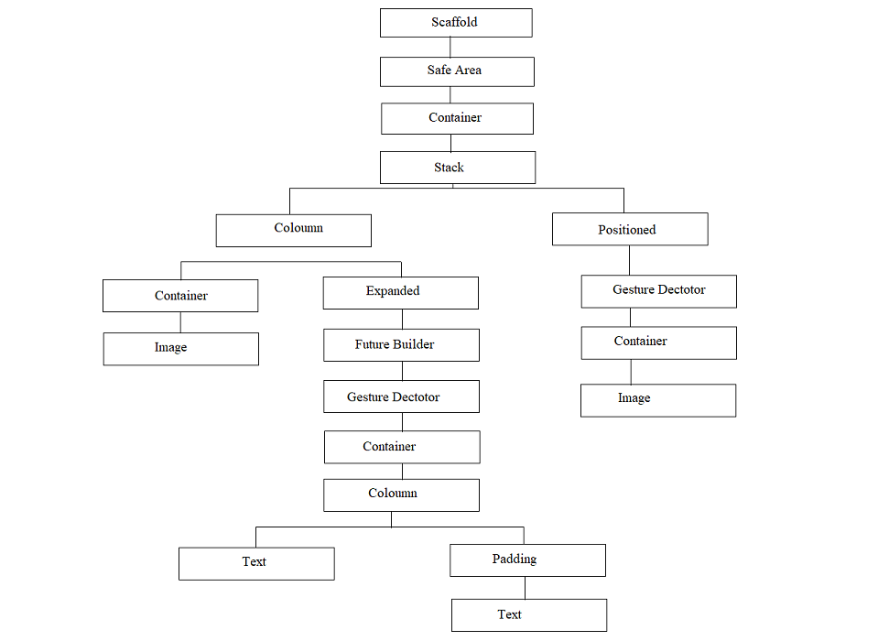
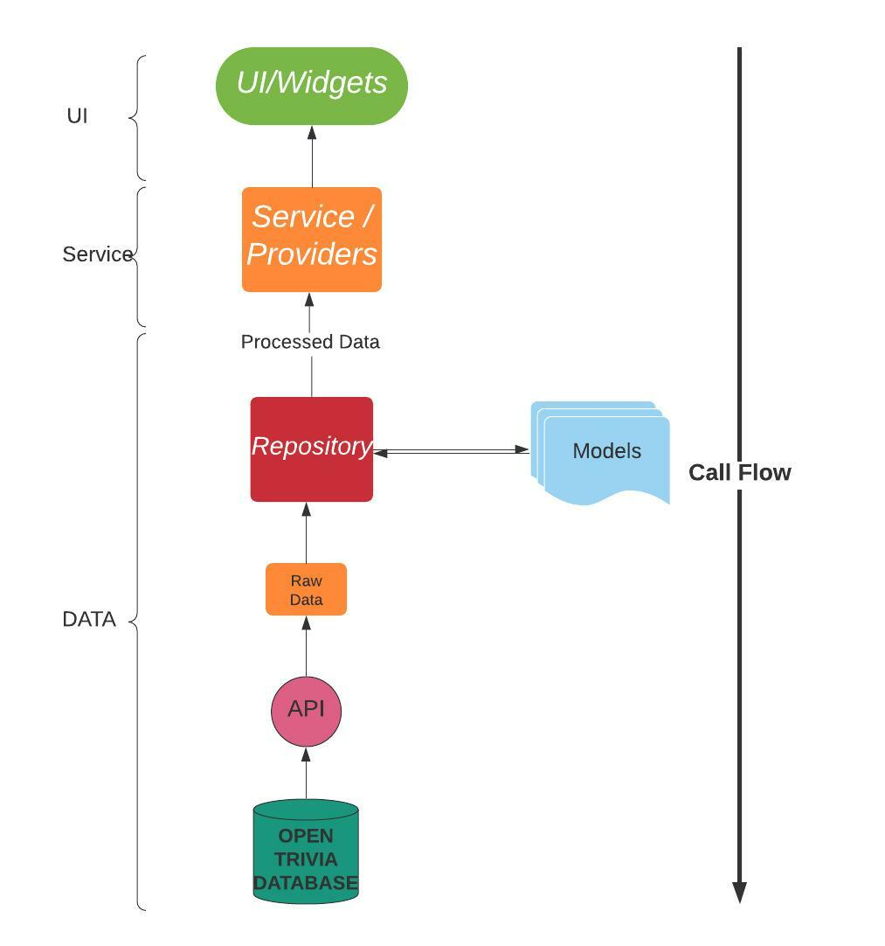
SYSTEM DESIGN

Slide 9
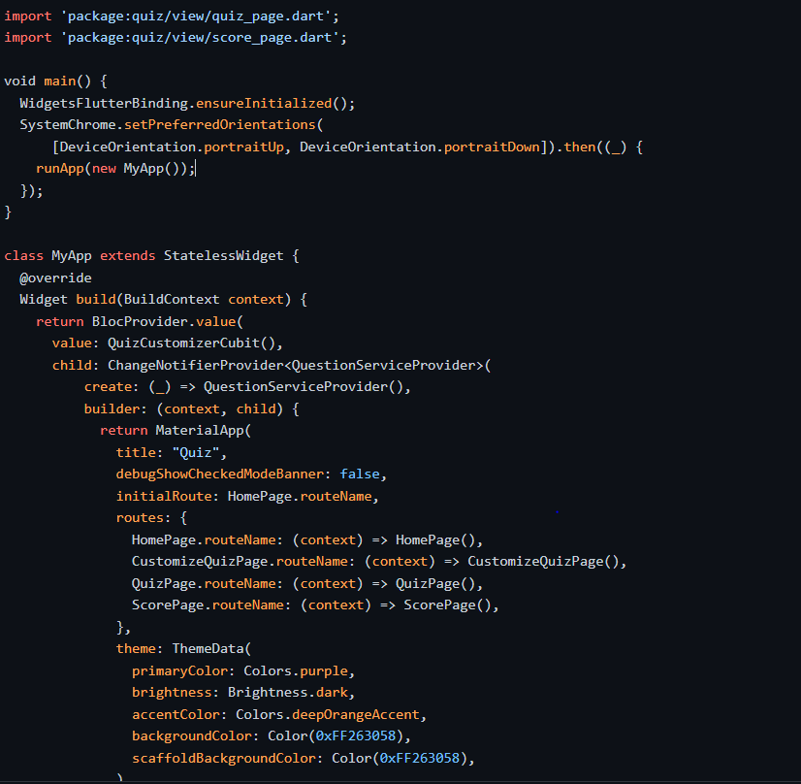
IMPLEMENTATION/CODING
main.dart
}
}

Slide 10
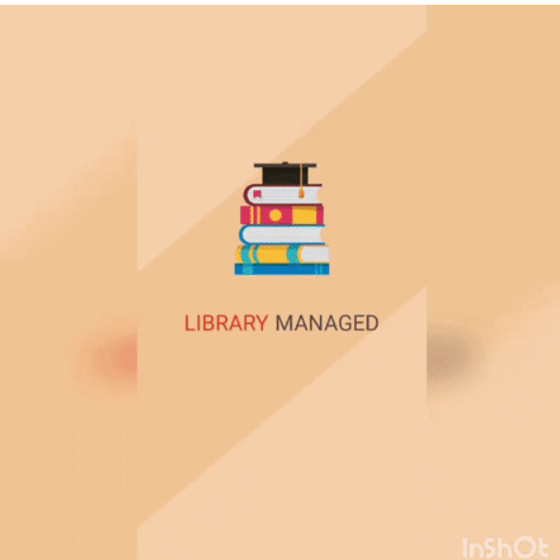
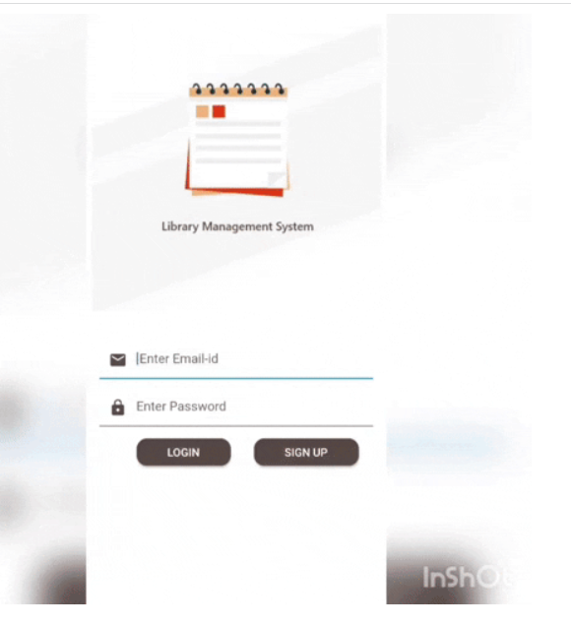
RESULTS
Home Page

Slide 11
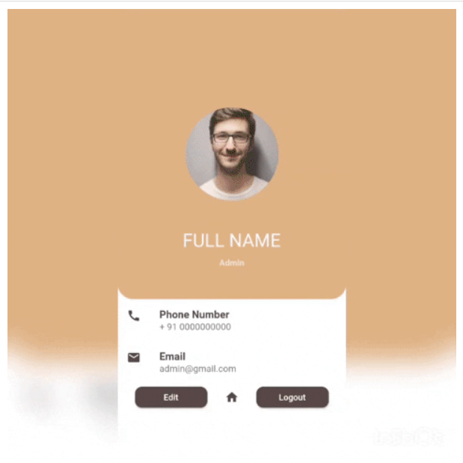
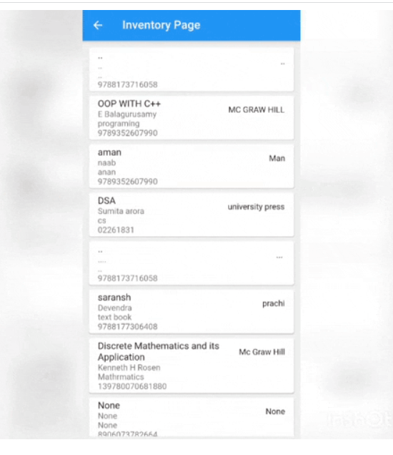
Author Page
Inventory page

Slide 12
TESTING
Testing is a process of executing a program with the interest of finding an error. Levels Of Testing
Unit Testing
Integration Testing
Validation Testing
Output Testing
User Acceptance Testing

Slide 13
CONCLUSIONS
The Library App is very important in future learning systems; it can be easily adopted by educational institutions and universities in order to make the quiz more flexible and safer.
The results are shown instantly to students.
The proposed system is easy and flexible for future maintenance and development because each subsystem can be handled separately without influence on another system.

Slide 14
FUTURE ENHANCEMENTS
We can add the functionality for a user to acess without google or email.
We can add the functionality for user to make payment online.

Slide 15
REFERENCES
[1] https://flutter.dev/
[2] https://developers.google.com/learn/pathways/intro-to-flutter
[3] Beginning Flutter: A Hands On Guide to App Development by Marco L
Napoli
[4] https://stackoverflow.com/

Slide 16
THANK YOU

